Slide 1
Chapter 8
Economic Fluctuations, Unemployment, and Inflation

Slide 2
Swings in the Economic Pendulum

Slide 3
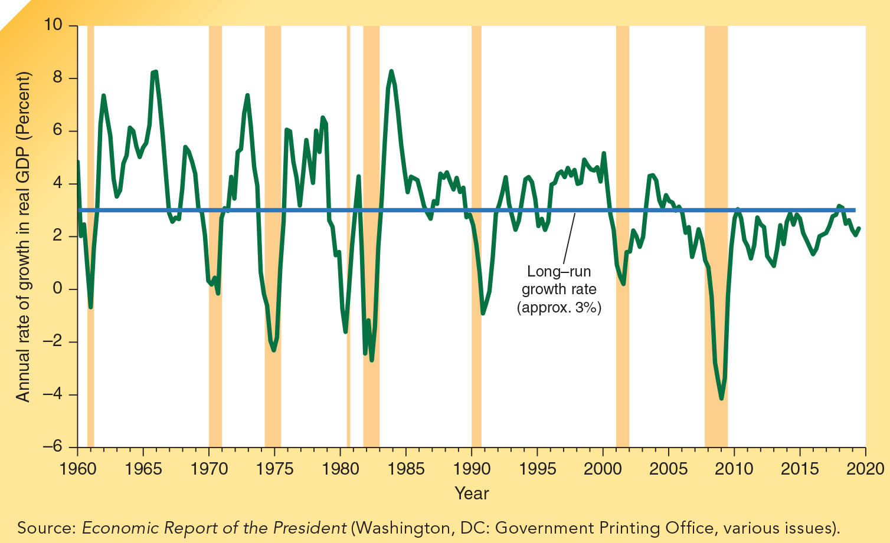
Instability in the
Growth of Real GDP: 1960-2019
Although real GDP in the United States has grown at an average rate of approximately 3%, the growth has been characterized by economic ups-and-downs.
Note: periods of recession are indicated with shading.
Notes:
During the last hundred years, the annual growth rate of real GDP in the United States has averaged approximately 3 percent. But there have been considerable fluctuations in the year-to-year growth. During the Great Depression of the 1930s, economic growth plunged. Real GDP declined by 6 percent or more each year from 1930 to 1932. In 1933, it was more than 25 percent less than it was in 1929. The 1938 level of real GDP was virtually the same as the 1929 level. World War II was characterized by a rapid expansion of GDP, which was followed by a decline after the war. Real GDP did not reach its 1944 level again until 1951.

Slide 4
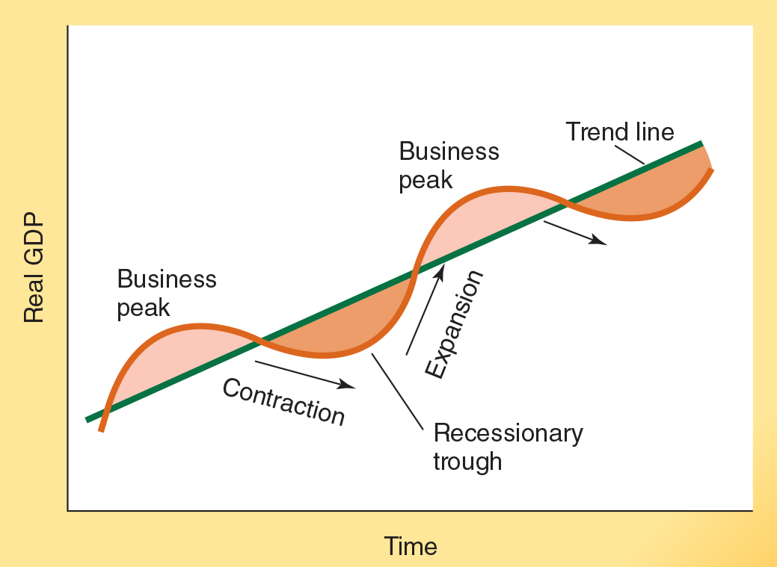
The Hypothetical Business Cycle
The four phases of the hypothetical business cycle are expansion, peak, contraction, and recessionary trough.
In contrast with the business cycle represented here, as the previous exhibit illustrated, real world business cycles are characterized by expansions and contractions of varying duration and magnitude.
Notes:
The United States and other industrial economies have been characterized by instability when it comes to the growth of real GDP. Inevitably, real GDP growth has been followed by economic slowdowns. Economists refer to these swings in the rate of output as the business cycle.
When most businesses are operating at capacity level and real GDP is growing rapidly, a business peak, or boom, is present. As business conditions slow, the economy begins the contraction, or recessionary, phase of the cycle. During the contraction, the sales of most businesses decline, real GDP grows at a slower rate or perhaps falls, and unemployment in the labor market increases.
The bottom of the contraction phase is referred to as the recessionary trough. After the downturn reaches the bottom and economic conditions begin to improve, the economy enters the expansion phase of the cycle. Here business sales rise, GDP grows rapidly, and the rate of unemployment declines.
The term recession is widely used to describe conditions during the contraction and recessionary trough phases of the business cycle. This is a period during which real GDP declines. Often, a recession is defined as a decline in real GDP for two or more consecutive quarters.

Slide 5
Economic Fluctuations and the Labor Market

Slide 6
Labor Market Classifications
Employed – a person (16 years old or over) who is:
working for pay at least one hour per week,
Unemployed – a person not currently employed who is:
actively seeking a job, or,
self employed, or,
working 15 hours or more each week without pay in a family-operated enterprise.
waiting to begin a job, or,
on layoff, waiting to return to a previous job.
Notes:
People aged 16 years and older are considered employed if they
worked at all (even as little as 1 hour) for pay or profit during the survey week,
worked 15 hours or more without pay in a family- operated enterprise during the survey week, or
have a job at which they did not work during the survey week because of illness, vacation, industrial disputes, bad weather, time off, or personal reasons.
Individuals are considered unemployed if they
do not have a job,
are available for work, and
have actively looked for work during the past four weeks. Looking for work involves activities such as registering at a public or private employment office, responding to an advertisement for employment, or writing letters of application.

Slide 7
Labor Market Classifications
Civilian Labor force – civilians (16 years & older) who are:
either employed or unemployed.
Not in the labor force – persons (16 years & older) who are:
neither employed nor unemployed (like retirees, students, homemakers, or disabled persons).

Slide 8
Labor Market Indicators
The non-institutional civilian adult population is grouped into two broad categories:
Persons not in the labor force, and,
$$\begin{matrix}Labor Force \\ Participation Rate\end{matrix}=\frac{\# in the Labor Force}{Civilian Population (16+)}$$
■8(𝐿𝑎𝑏𝑜𝑟 𝐹𝑜𝑟𝑐𝑒@𝑃𝑎𝑟𝑡𝑖𝑐𝑖𝑝𝑎𝑡𝑖𝑜𝑛 𝑅𝑎𝑡𝑒)=(# 𝑖𝑛 𝑡ℎ𝑒 𝐿𝑎𝑏𝑜𝑟 𝐹𝑜𝑟𝑐𝑒)/(𝐶𝑖𝑣𝑖𝑙𝑖𝑎𝑛 𝑃𝑜𝑝𝑢𝑙𝑎𝑡𝑖𝑜𝑛 (16+))
Recall that the $Labor Force=Employed+Unemployed$
Recall that the 𝐿𝑎𝑏𝑜𝑟 𝐹𝑜𝑟𝑐𝑒=𝐸𝑚𝑝𝑙𝑜𝑦𝑒𝑑+𝑈𝑛𝑒𝑚𝑝𝑙𝑜𝑦𝑒𝑑
persons in the labor force (this group includes both the employed and unemployed).

Slide 9
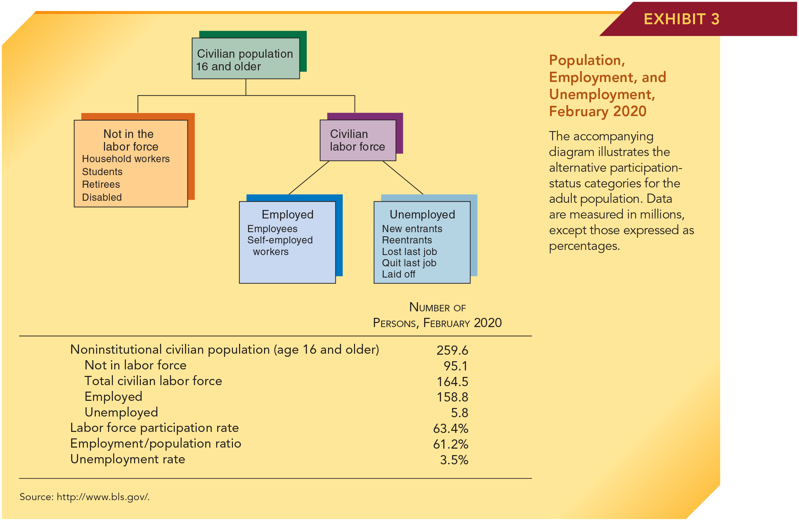
U.S. Population, Employment, and Unemployment: February 2020
Source: http://www.bls.gov/.
$$\begin{matrix}Labor Force \\ Participation Rate\end{matrix}=\frac{Civilian Labor Force}{Civilian Population (16+)}=\frac{164.5}{259.6}=63.4\%$$
■8(𝐿𝑎𝑏𝑜𝑟 𝐹𝑜𝑟𝑐𝑒@𝑃𝑎𝑟𝑡𝑖𝑐𝑖𝑝𝑎𝑡𝑖𝑜𝑛 𝑅𝑎𝑡𝑒)=(𝐶𝑖𝑣𝑖𝑙𝑖𝑎𝑛 𝐿𝑎𝑏𝑜𝑟 𝐹𝑜𝑟𝑐𝑒)/(𝐶𝑖𝑣𝑖𝑙𝑖𝑎𝑛 𝑃𝑜𝑝𝑢𝑙𝑎𝑡𝑖𝑜𝑛 (16+))=164.5/259.6=63.4%
$$\begin{matrix}Employment to \\ Population Ratio\end{matrix}=\frac{Number Employed}{Civilian Population (16+)}=\frac{158.8}{259.6}=61.2\%$$
■8(𝐸𝑚𝑝𝑙𝑜𝑦𝑚𝑒𝑛𝑡 𝑡𝑜 @𝑃𝑜𝑝𝑢𝑙𝑎𝑡𝑖𝑜𝑛 𝑅𝑎𝑡𝑖𝑜)=(𝑁𝑢𝑚𝑏𝑒𝑟 𝐸𝑚𝑝𝑙𝑜𝑦𝑒𝑑)/(𝐶𝑖𝑣𝑖𝑙𝑖𝑎𝑛 𝑃𝑜𝑝𝑢𝑙𝑎𝑡𝑖𝑜𝑛 (16+))=158.8/259.6=61.2%
$$\begin{matrix}Rate of \\ Unemployment\end{matrix}=\frac{Number Unemployed}{Civilian Labor Force}=\frac{5.8}{164.5}=3.5\%$$
■8(𝑅𝑎𝑡𝑒 𝑜𝑓 @𝑈𝑛𝑒𝑚𝑝𝑙𝑜𝑦𝑚𝑒𝑛𝑡)=(𝑁𝑢𝑚𝑏𝑒𝑟 𝑈𝑛𝑒𝑚𝑝𝑙𝑜𝑦𝑒𝑑)/(𝐶𝑖𝑣𝑖𝑙𝑖𝑎𝑛 𝐿𝑎𝑏𝑜𝑟 𝐹𝑜𝑟𝑐𝑒)=5.8/164.5=3.5%

Slide 10
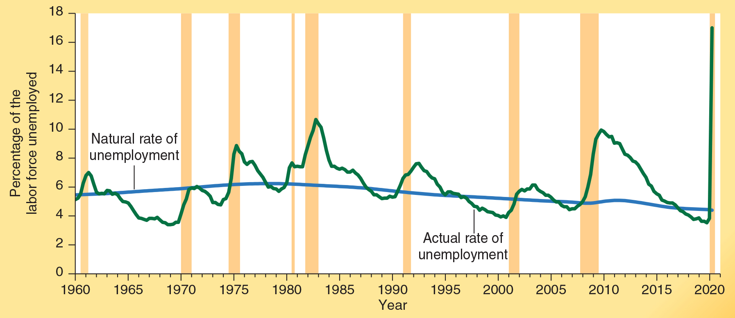
Employment Fluctuations and Trends:
The Historical Record
The unemployment rate from 1960-2020 is illustrated here.
As expected, unemployment rose rapidly during each of the eight recessions (the shaded years indicate periods of recession).
In contrast, after each recession ended, the unemployment rate began to decline soon after the economy moved into an expansionary phase of the business cycle.
Note that the actual rate of unemployment was greater than the natural rate during and immediately following each recession.
Source: https://research.stlouisfed.org/fred2/.
Notes:
Employment and output are closely linked over the business cycle. If we are going to produce more goods and services, we must either increase the number of workers or increase the output per worker. Although productivity, or output per worker, is the primary source of long-term economic growth, it changes slowly from year to year. Consequently, rapid increases in output, such as those that occur during a strong business expansion, generally require an increase in employment. As a result, output and employment tend to be positively related. Conversely, there is an inverse relationship between growth of output and the rate of unemployment.

Slide 11
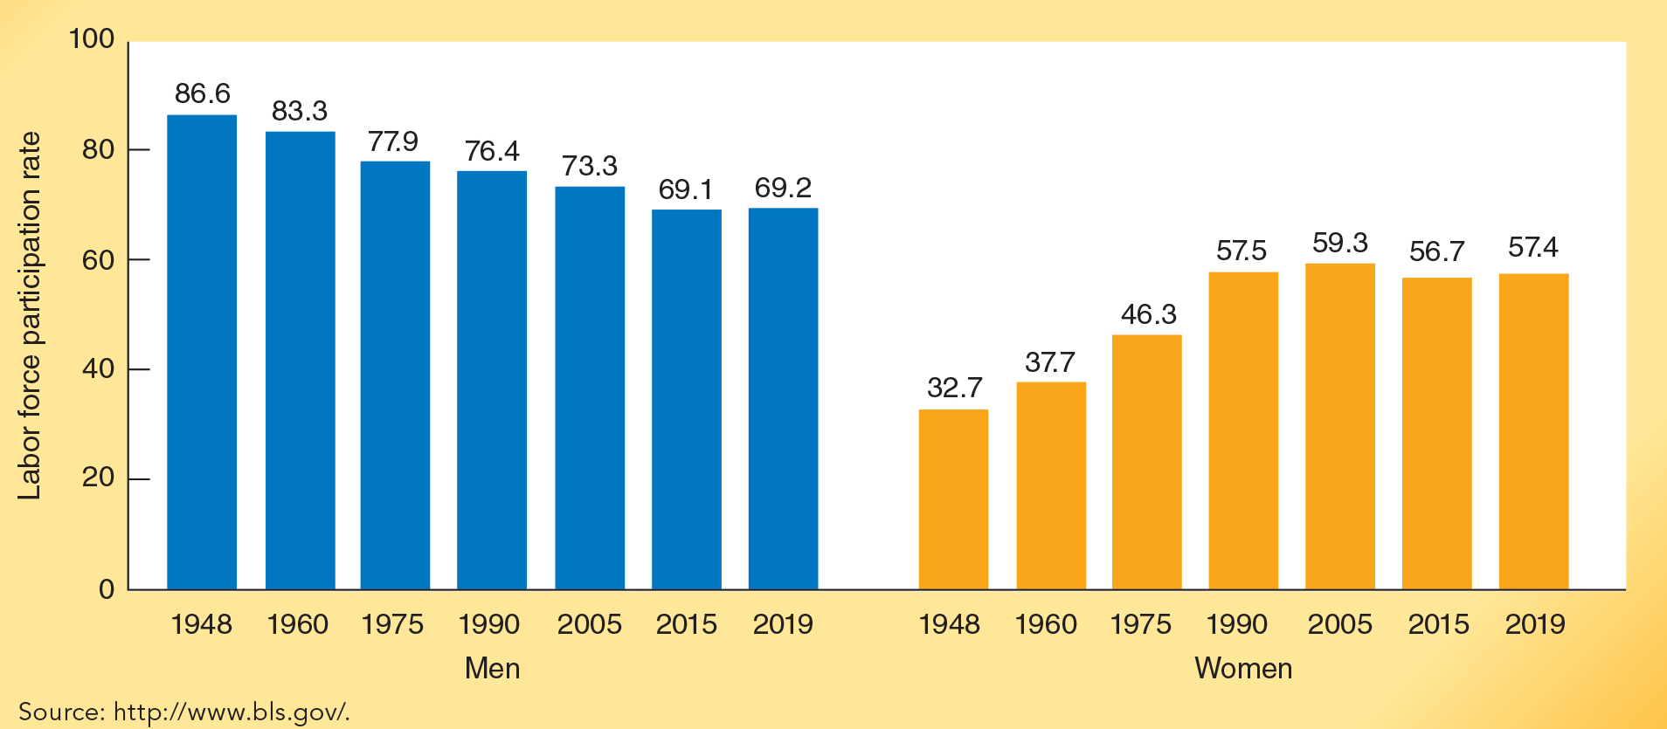
Labor Force Participation Rate of Men and Women, 1948-2015
The labor force participation rate of women has been steadily increasing for several decades.
During the same period the rate of men has been falling.
Notes:
During the last half of the twentieth century, there was a dramatic increase in the labor force participation rate of women. In 2005, 58.6 percent of women worked outside the home, up from 32.7 percent in 1948. Married women accounted for most of this increase. More than half of all married women now are in the labor force, compared to only 20 percent immediately following World War II. Since 2005, there has been a small decline in the labor force participation rate of women. In contrast with women, the labor force participation rate of men fell. In 2019, the labor force participation rate of men was 69.2 percent, down from 83.3 percent in 1960 and 86.6 percent in 1948. Clearly, the composition of workforce participation within the family has changed substantially during the past seven decades.

Slide 12
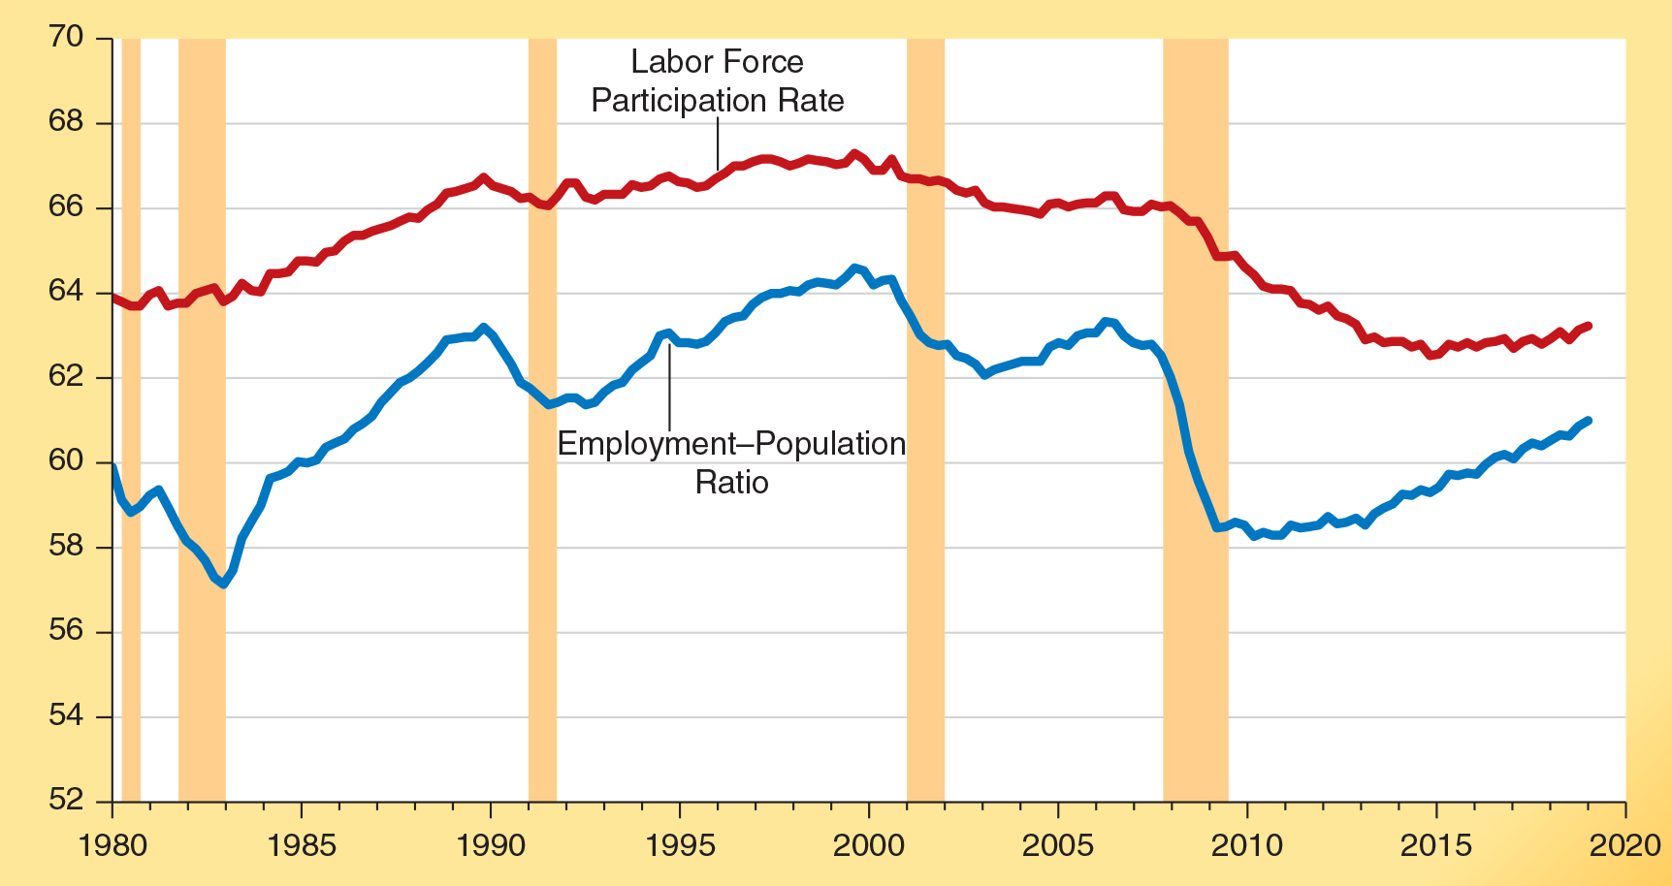
Labor Force Participation Rate and
Employment-Population Ratio: 1980-2019
Both the labor force participation rate and the employment-population ratio trended upward from 1980-2000, but have been declining since.
Both figures fell sharply during the 2008-2009 recession. Each has had a weak rebound during the recovery phase of this business cycle. In 2019, both were still below their 2007 levels.
Notes:
Both figures trended upward during the 1980s and 1990s. The labor force participation rate rose from 64 percent in 1980 to 67 percent in 2000. During this same period, the employment–population ratio increased from 60 percent to 64 per- cent. The increasing labor force participation of women boosted both of these rates during the 1980s and 1990s.
Since 2000, however, the trend has reversed. By the last quarter of 2019, the labor force participation rate stood at 63.2 percent, near its lowest level in more than three decades. In the last quarter of 2019, the employment-population ratio was 61.0 percent. While most of the reductions in labor force participation and employment came during the 2008–2009 recession, both have increased only modestly since the recession ended in June 2009. Economic studies indicate a majority of the recent decline in the labor force participation rate is due to cyclical rather than demographic factors.

Slide 13
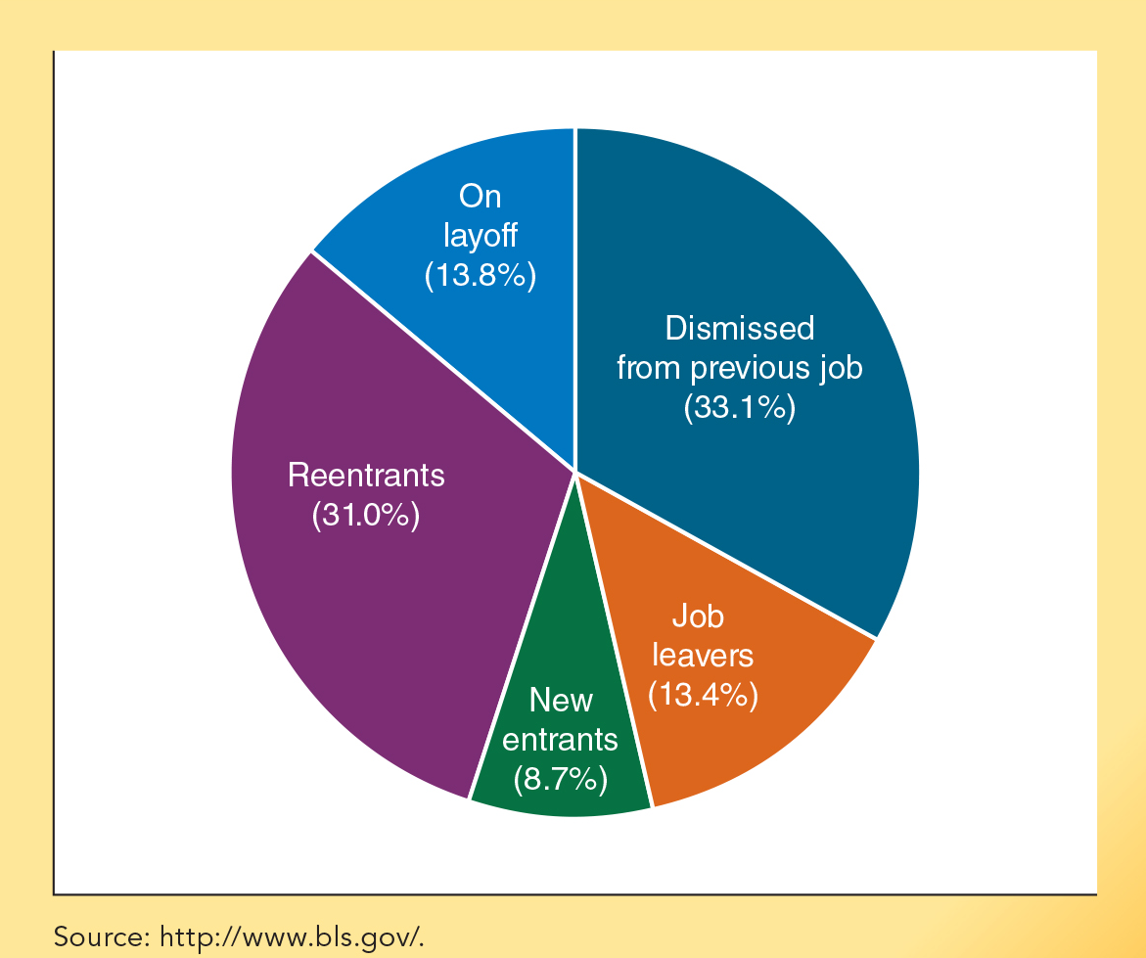
Composition of the Unemployed by Reason in 2020 (February)
There are various reasons why persons were unemployed in February of 2020.
One-third (33.1%) of the unemployed were dismissed from their previous jobs.
Two-fifths (39.7%) of the unemployed were either new entrants or reentrants into the labor force.
Notes:
Unemployment may occur for reasons other than the loss of a job, however. For ex- ample, people often experience periods of unemployment as they enter and reenter the labor force. The Department of Labor lists five reasons why workers may experience un- employment.

Slide 14
The Unemployment Rate
By Age and Gender: February 2020
In 2020, the unemployment rate was 3.6% for men and 3.4% for women.
The unemployment rates of younger men are higher than the rates for women.
The unemployment rate itself was also much higher for those under the age of 25 than for those over the age of 25.
Source: http://www.bls.gov/.

Slide 15
Questions for Thought:
1. Classify the following as employed, unemployed, or not in labor force:
(a) person who is not working but applied for a job at Target last week
(b) person working part-time and searching diligently for a full-time job
(c) auto worker vacationing in Florida during a layoff at a General Motors plant who expects to be recalled in a couple of weeks
(d) 17-year-old who works 6 hours per week throwing newspapers
(e) homemaker working 70 hours a week preparing meals and performing other household services
(f) college student who spends between 50 and 60 hours per week attending classes and studying
(g) a retired Social Security recipient

Slide 16
Questions for Thought:
2. The following are for the U.S. in October of 2020 (in millions)
Population: 331
Civilian pop. (age 16 and over): 260.9
Employed: 149.8
Unemployed: 11.1
(a) Calculate the unemployment rate
(b) Calculate the labor force participation rate
(c) Calculate the employment to population ratio

Slide 17
Three Types of Unemployment

Slide 18
Three Types of Unemployment
Frictional Unemployment:
Caused by imperfect information.
Occurs because:
employers are not aware of all available workers and their qualifications, and,
available workers are not fully aware of all the jobs being offered by employers.
Notes:
An employer looking for a new worker seldom hires the first applicant who walks into the employment office. The employer wants to find the “best available” worker to fill the opening. It is costly to hire workers who perform poorly. It is sometimes even costly to terminate their employment. So, employers search—they expend time and resources screening applicants in an effort to find the best-qualified workers who are willing to accept their wage and employment conditions.
Similarly, job seekers are searching for the employment opportunity that best fits their skills, earning capabilities, and preferences. They make telephone calls, search newspaper ads and internet sites, submit job applications, go to job interviews, use employment services, and so on. The pursuit of personal gain—landing jobs that are more attractive than the current options they face—motivates job seekers to engage in job search activities.

Slide 19


Entrepreneurs Who have
Changed Our Lives: Sergey Brin and Larry Page
• Job search is vitally important for the efficient operation of labor markets. In recent years, Google Inc., a company founded by Sergey Brin and Larry Page, has dramatically improved the search process in numerous areas, including labor markets.
• Brin and Page met as graduate students at Stanford, both working on their Ph.D. in computer science. As Page tells it, he had a slew of ideas for his Ph.D. dissertation, but his adviser liked one especially: studying how information was linked on the World Wide Web. That led to the creation of Google, Inc. (“googol” is the number 1 followed by 100 zeros).
• Before Google, Internet users struggled to find relevant information out of billions of bits of information scattered across the World Wide Web. They never got their Ph.D.s, but they became multibillionaires, creating a company that in 2019 conducted 3.5 billion searches a day.
Xavier Collin/Image Press Agency/Alamy
CHRISTOPH DERNBACH/dpa/
Alamy Live News/Alamy
Notes:
Sergey Brin was born in Moscow in 1973, son of a mathematical economist who brought his family to the United States to avoid Jewish persecution. Larry Page was born the same year in East Lansing, Michigan, where his father pioneered artificial intelligence and his mother taught computer programming.
Page and Brin figured they could simplify the search process by creating a search engine that would rank Web pages based on popularity. Dropping out of graduate school, they used their credit cards and those of their parents and friends to launch Google in 1998 in a garage in Menlo Park, California. “Even when we started Google, we thought, ‘Oh, we might fail,’ and we almost didn’t do it,” recalls Page. “The reason we started is that Stanford said, ‘You guys can come back and finish your Ph.D.s if you don’t succeed.’”
In 2004, Google’s stock went public. Even the stock offering was innovative—a “Dutch auction,” whereby anyone, including individual investors, could bid on the shares. The bidder specified a price as high or low as he or she wanted and the number of shares to be purchased at that price. Following the auction, the stock opened on the market at just over $100 per share. Over time, Google added new businesses, bought YouTube, and restructured; the stock of its parent company, Alphabet, traded at $1,487 in early 2020. The two founders of Google retired in 2019, having earned their fortunes by designing a system that benefits people around the globe.

Slide 20
Three Types of Unemployment
Structural Unemployment:
Reflects an imperfect match of employee skills to skill requirements of the available jobs.
Cyclical Unemployment:
Reflects business cycle conditions
Also reflects structural and demographic characteristics of the labor market.
When there is a general downturn in business activity, cyclical unemployment increases.
Notes:
Structural unemployment: The introduction of new products and production technologies can substantially alter the relative demand for workers with various skills. Changes of this type can affect the job opportunities of even highly skilled workers, particularly if their skills are not easily transferable to other industries and occupations. The “computer revolution” has dramatically changed the job opportunities of many workers. The alternatives available to workers with the skills required to operate and maintain high-tech equipment have improved substantially, while the prospects of those without such skills have, in some cases, deteriorated drastically.
Cyclical unemployment: An unexpected fall in the general level of demand for goods and services will cause cyclical unemployment to rise. When the demand for labor declines, workers will at first not know whether they are being laid off because their employer is experiencing lower demand or if the reduction in demand is widespread throughout the economy.

Slide 21
Full Employment and the
Natural Rate of Unemployment

Slide 22
The Concept of Full Employment
Full Employment:
Level of employment resulting when the rate of unemployment is normal, considering both frictional and structural factors.
Natural Rate of Unemployment:
Level of unemployment that reflects “job shopping” in an economy of imperfect information and dynamic change.
Full employment is closely related to the concept of the natural rate of unemployment.
Notes:
Full employment, a term widely used by economists and public officials alike, does not mean zero unemployment. In a world of imperfect information, both employees and employers will “shop” before they agree to accept a job or hire a new worker. Much of this shopping is efficient, because it leads to better matches between the skills of employees and the skills employers need. Some unemployment is therefore necessary for a dynamic labor market to operate efficiently. Consequently, economists define full employment as the level of employment that results when the rate of unemployment is “normal,” considering both frictional and structural factors.
The natural rate of unemployment is not a temporary high or low; it is a rate that is sustainable. Economists sometimes refer to it as the unemployment rate accompanying the economy’s “maximum sustainable” rate of output. When unemployment is at its natural rate, full employment is present, and the economy is achieving the highest rate of output that it can sustain.

Slide 23
The Concept of the Natural Rate of Employment
The natural rate of unemployment is:
neither a temporary high nor temporary low.
Both demographic factors (e.g. young workers as a share of the labor force) and public policy (e.g. the level of unemployment benefits) influence the natural rate of unemployment.
Actual rate of unemployment generally rises above natural rate during a recession and falls below the natural rate during a boom.
a rate that is both achievable and sustainable.
the level of unemployment accompanying an economy’s “maximum sustainable rate of output.”

Slide 24
Actual and Potential GDP

Slide 25
Actual and Potential GDP
Potential output:
Maximum sustainable output level consistent with the economy’s resource base, given its institutional arrangements.
Actual and potential output will be equal when the economy is at full employment.
Notes:
If an economy is going to realize its potential, full employment is essential. When the actual rate of unemployment exceeds the natural rate, the actual output of the economy will fall below its potential. Potential output does not represent the absolute maximum level of production that could, for example, be generated in wartime or other situations during which the level of aggregate demand is abnormally high. Rather, it is the rate that would be expected under more normal circumstances.

Slide 26
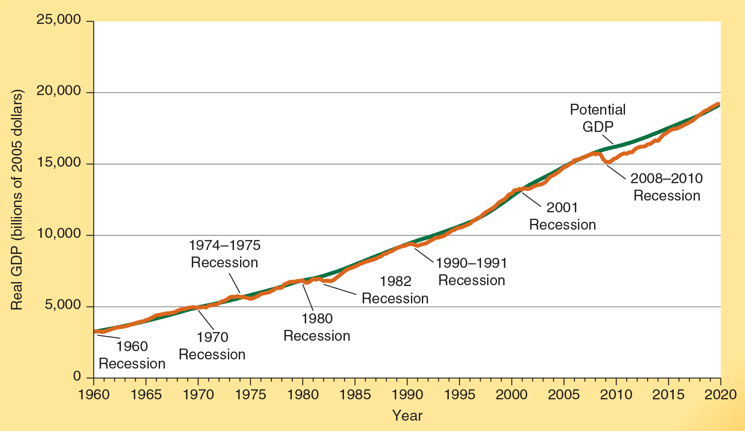
Actual and Potential GDP, 1960-2020
Here we illustrate both actual GDP and potential GDP.
Note the gap between actual and potential GDP during periods of recession.
Source: http://www.bls.gov.

Slide 27
Questions for Thought:
1. During a recession, which of the following will be true?
(a) Actual rate of unemployment will be lower than the natural rate.
(b) Actual GDP will be lower than potential GDP.
(c) Actual employment will exceed what is considered as full employment.
2. How will increased usage of the Internet by employers and employees influence the job search process? Will it tend to increase or decrease the natural rate of unemployment?
3. (True or false) When full employment is present the rate
of unemployment will be zero.

Slide 28
Questions for Thought:
4. What is the relationship between full employment and the natural rate of unemployment? Why might the natural rate change?
5. Frictional unemployment is a result of:
(a) not enough jobs for everyone to be employed
(b) unemployed workers’ skills not matching those needed for available jobs
(c) a decline in the demand for labor, such as during a recession
(d) imperfect information and temporary periods of unemployment while workers change jobs

Slide 29
The Effects of Inflation

Slide 30
Inflation
Inflation is a change in the general level of prices as measured by a price index such as the GDP deflator or the consumer price index.
Inflation is generally measured at an annual rate.
When inflation is high, the year-to-year changes in the inflation rate are nearly always highly variable, making them difficult to predict.
Notes:
Inflation is a sustained increase in the general level of prices. When inflation is on the rise, it costs more to purchase a typical bundle of goods and services. Of course, even when the general level of prices is stable, some prices will be rising and others will be falling. During a period of inflation, however, the impact of the rising prices will outweigh the impact of falling prices. Because of the higher prices (on average), a dollar will purchase less than it did previously. Inflation, therefore, can also be defined as a decline in the value (the purchasing power) of money.

Slide 31
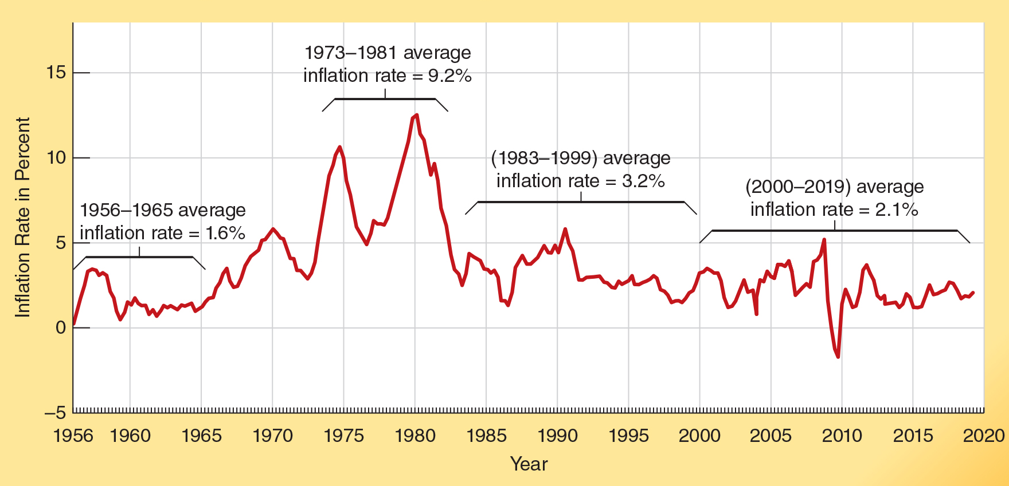
The Inflation Rate, 1956-2020
Between 1956 and 1965, the general price level increased
at an average annual rate of only 1.6%.
In contrast, the inflation rate averaged 9.2% from 1973 to 1981, reaching double-digits during several years.
During 1983-1999 the inflation rate was much lower (3.2%).
Since 2000, the inflation rate has been lower still (2.1%).

Slide 32
Unanticipated and Anticipated Inflation
There are two different kinds of inflation:
Unanticipated inflation:
An increase in the price level that comes as a surprise, at least for most individuals.
Anticipated inflation:
A widely expected change in the price level.
Notes:
Unanticipated inflation: Suppose that, based on the recent past, most people anticipate an inflation rate of 3 percent. If the actual inflation rate turns out to be 10 percent, it will catch people off guard. When the inflation rate is high and variable, it will be virtually impossible for people to anticipate it accurately. This was the case in the United States during the 1970s.
Anticipated inflation: Decision-makers are generally able to anticipate slow, steady rates of inflation with a high degree of accuracy. When the general level of prices is more stable, this will exert a positive impact on real output and the level of prosperity. During the 1983–2019 period, U.S. inflation was low and relatively stable. This 36-year period was characterized by persistent growth and only 34 months of recession.

Slide 33
Effects of Inflation
High and variable rates of inflation are harmful for several reasons:
Because unanticipated inflation alters the outcomes of long-term projects like the purchase of a machine or operation of a business, it will both increase the risks and retard the level of investment.
Inflation distorts the information delivered by prices.
People will respond to high and variable rates of inflation by spending less time producing and more time trying to protect their wealth and income from the uncertainty created by inflation.
Notes:
High and variable inflation reduces investment. When the price level rises 15 percent one year and 40 percent the next year and then increases again by 20 percent the following year, no one knows what to expect. Unanticipated changes of even 5 percent or 10 percent in the rate of inflation can often turn an otherwise profitable project into a personal economic disaster. Given the uncertainty that it creates, many decision makers will simply forgo capital investments and other transactions involving long-term commitments.
Inflation distorts the information delivered by prices. Time delays will occur before the prices accompanying rental lease agreements, mortgage interest rates, and collective bargaining contracts can be changed. Because some prices will respond quickly to inflation whereas others will change more slowly, an unanticipated change in the rate of inflation will change relative prices as well as the general price level. The distorted relative prices will be a less reliable indicator of relative scarcity.
High and variable inflation results in less productive use of resources. Managers will spend more time coping with frequent price changes and less time improving production methods and products. Speculative market practices will occur as people try to outguess one another about the future direction of prices. As a result, funds will flow into speculative-type investments instead of more productive ones that increase output.

Slide 34
What Causes Inflation?
Nearly all economists believe that rapid expansion in the money supply is the primary cause of inflation.

Slide 35
Questions for Thought:
1. Suppose that the CPI was 150 at the end of last year and 157.5 at the end of this year. What was the inflation rate during the year?
2. If decision makers anticipate an inflation rate of 3% at the start of a year and prices rise by 7% during the year, this is an example of
(a) anticipated inflation.
(b) an inflation rate higher than the anticipated.
(c) an inflation rate lower than the anticipated.
3. (True or false) When the inflation rate is high and variable, decision makers will generally be able to anticipate year-to-year changes in inflation quite accurately.

Slide 36
Questions for Thought:
4. How would an unanticipated jump in inflation impact the wealth of:
(a) Joe, who has a 30-yr home mortgage at a fixed interest rate
(b) The McCoy's, who hold most of their wealth in long-term fixed yield bonds
(c) Hanna, a retiree drawing a pension of a fixed dollar amount
(d) Jose, a heavily indebted small-business owner.
(e) Mike, the owner of an apartment complex with substantial debt at a fixed interest rate
(f) Tina, a worker whose wages are determined by a 3-year union contract ratified three months ago

Slide 37
Questions for Thought:
5. What impact will high and variable rates of inflation have on the economy? How will they influence the risk accompanying long-term contracts and related business decisions?
6. Compared to the United States, labor markets in France, Italy, and Spain are characterized by more generous unemployment benefits. Other things constant, how will this influence the unemployment rate in in these countries compared to that in the U.S.? Explain.

Slide 38
End of Chapter 8

